Slide 1
QUEUEING THEORY (WAITING LINE THEORY)

Slide 2
Introduction
The study of waiting lines, called queuing theory is one of the oldest and most widely used Operations Research techniques. Waiting lines are the most frequently encountered problem in our daily life.
The queuing theory, also called the waiting line theory, owes its development to A. K. Erlang’s efforts to analyze telephone traffic congestion with a view to satisfying the randomly arising demand for the services of the Corpenhagen automatic telephone system, in the year 1909.
The theory is applicable to situation where the customers arrive at some service stations for some service; wait (occasionally not); and then leave the system after getting the service.

Slide 3
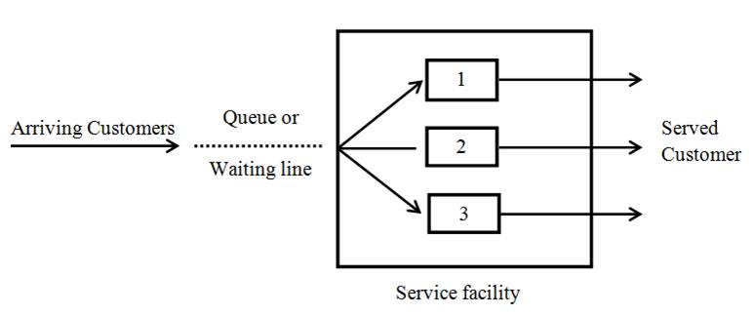
Queueing system
The mechanism of a queuing process is very simple. Customers arrive at services counter are attended by one or more of the servers. As soon as a customer is served, he departs from the system.
A queuing system can be described as composed of customers arriving for service, waiting for service if it is not immediate, and if having wanted for service, leaving the system after being served.

Slide 4
Components of a Queuing System
A queuing system can be described by the following components:
1. Input process (or Arrival pattern)
This is considered with the pattern in which the customers arrive and join the system. An input source is characterized by
a) Size of the calling population.
b) Pattern of arrivals at the system.
c) Behavior of the arrivals.
Customers requiring service are generated at different times by an input source, commonly known as population. The rate at which customers arrive at the service facility is determined by the arrival process.

Slide 5
Components of a Queuing System
Size of the population :
The size represents the total number of potential customers who will require service. The source of customers can be either finite or infinite. It is considered infinite if the number of people being very large e.g. all people of a city or state (and others) could be the potential customers at a milk parlour.
b) Pattern of arrivals at the system:
Customers arrive in the system at a service facility according to some known schedule (for example one patient every 15 minutes or a candidate for interview every half hour) or else they arrive randomly. Arrivals are considered at random when they are independent of one another and their occurrence cannot be predicted exactly

Slide 6
Components of a Queuing System
2.Service Mechanism (or Service Pattern)
The service is provided by a service facility (or facilities). This may be a person (a bank teller, a barber, a machine (elevator, gasoline pump), or a space (airport runway, parking lot, hospital bed), to mention just a few. A service facility may include one person or several people operating as a team. There are two aspects of a service system
a) the configuration of the service system
b) the speed of the service.

Slide 7
Components of a Queuing System
a. Configuration of the service system
The customers entry into the service system depends upon the queue conditions. If at the time of customers arrival, the server is idle, then the customer is served immediately. Otherwise the customer is asked to join the queue, which can have several configurations. By configuration of the service system we mean how the service facilities exist. Service systems are usually classified in terms of their number of channels, or numbers of servers.

Slide 8
Components of a Queuing System
i) Single Server - Single Queue : The models that involve one queue - one service station facility are called single server models where customer waits till the service point is ready to take him for servicing. Students arriving at a library counter are an example of a single server facility.
Single Server - Several Queues : In this type of facility there are several queues and the customer may join any one of these but there is only one service channel.
Several (Parallel) Servers - Single Queue : In this type of model there is more than one server and each server provides the same type of facility. The customers wait in a single queue until one of the service channels is ready to take them in for servicing.

Slide 9
Component of a Queuing System
iv) Several Servers - Several Queues: This type of model consists of several servers where each of the servers has a different queue. Different cash counters in an electricity office where the customers can make payment in respect of their electricity bills provide an example of this type of model. Different ticket issue encounters in a trade fair and different boarding pass encounters at an airport are also other possible examples of this type of model.
v) Service facilities in a series : In this, a customer enters the first station and gets a portion of service and then moves on to the next station, gets some service and then again moves on to the next station. and so on, and finally leaves the system, having received the complete service. For example, in a milk plant packaging of milk pouches consist of boiling, pasteurization, cooling and packaging operations, each of which is performed by a single server in a series.

Slide 10
Components of a Queuing System
b) Speed of service
In a queuing system, the speed with which service is provided can be expressed in either of two ways as service rate and as service time. The service rate describes the number of customers serviced during a particular time period and the service time indicates the amount of time needed to service a customer.

Slide 11
Component of a Queuing System
3. Queue discipline
In the queue structure, the important thing to know is the queue discipline. The queue discipline is the rule determining the formation of queue, manner in which customers form the queue are selected for service. There are a number of ways in which customers in the queue are served. Some of these are:
a) Static queue disciplines
These are based on the individual customer's status in the queue. The most common queue disciplines are:
First-Come-First-Served (FCFS): If the customers are served in the order of their arrival, then this is known as the FCFS service discipline. For example, this type of queue discipline is observed at a milk parlor, railway station etc. FCFS is also known as First In First Out (FIFO).
Last-Come-First-Served (LCFS): Sometimes, the customers are serviced in the reverse order of their entry so that the ones who join the last are served first and the system is referred to as LCFS. For example, in a big go down the items which come last are taken out first. Similarly, the people who join an elevator last are the first ones to leave it.

Slide 12
Components of a Queuing System
b) Dynamic queue disciplines
These are based on the individual customer attributes in the queue. Few of such disciplines are:
Service in Random Order (SIRO): Under this rule customers are selected for service at random, irrespective of their arrivals in the service system. In this, every customer in the queue is equally likely to be selected. The time of arrival of the customers is, therefore, of no relevance in such a case.
Priority Service: Under this rule customers are grouped in priority classes on the basis of some attributes such as service time or urgency or according to some identifiable characteristic, and FCFS rule is used within each class to provide service. Treatment of VIPs in preference to other patients in a hospital is an example of priority service.

Slide 13
Components of a Queuing System
c) Customers behavior
Another thing to consider in the queuing structure is the behavior or attitude of the customers entering the queuing system. On this basis, the customers may be classified as being patient, or impatient.
Balking: A customer may leave the queue because the queue is too long or the estimated waiting time is too long or waiting space is inadequate, for desired service and may decide to return for service at a later time. In queuing theory this is known as balking.
Reneging: A customer, after joining the queue, waits for some time and leaves the service system due to intolerable delay or due to impatience.

Slide 14
Components of a Queuing System
Jockeying: A customer who switches from one queue to another, hoping to receive service more quickly, is said to be jockeying.
Priorities: In certain applications some customers are served before others regardless of their order of arrival. These customers have priority over others.

Slide 15
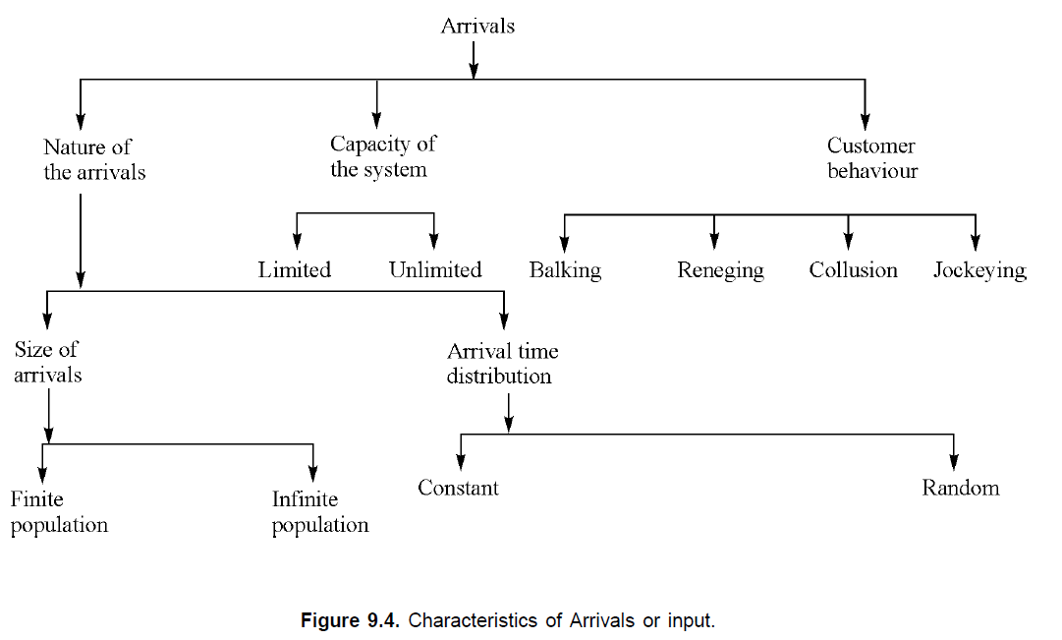

Slide 16
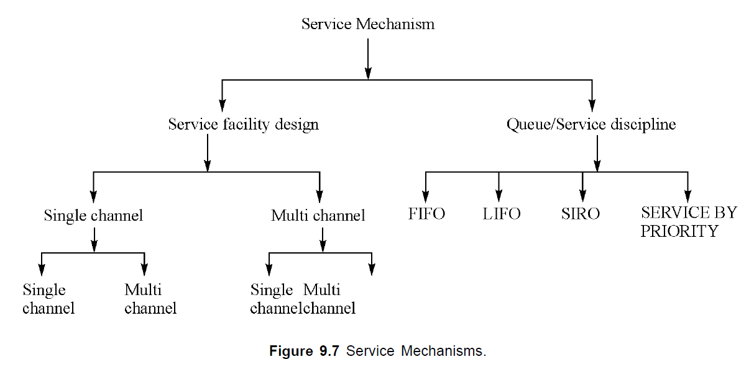
Service Mechanism or Service Facility

Slide 17
OPERATING CHARACTERISTICS OF A QUEUEING SYSTEM
For studying queuing system, we have to set up a set of equations. We have to solve these equations to determine the operating characteristics (or performance measures). There are two types of solutions of these equations: (i) Transient
(ii)Steady state.
Transient solutions: The time dependent solutions are known as transient solutions.
Steady state solutions: These solutions are independent of time and represent the probability of the system being in a particular state in the long run.

Slide 18
Operating characteristics/ Performance Measures
Performance Measures of a queuing system are determined by two statistical properties, namely, the probability distribution of inter-arrival times and the probability distribution of service times.
Some of the operating characteristics/performance measures of any queueing system that are of general interest for analyzing the system are listed below:
1. Ls: The average number of customers in the queuing system (those waiting to be served and those being served).
2. Ws: The average time each customer spends in the queuing system from entry into the queue to
completion of the service (the time spent waiting in the queue and during the service).
3. Lq: The average number of customers in the queue waiting to get service (this excludes customers
undergoing service).
4. Wq: The average time each customer spends in the queue waiting to get service (this excludes customers time spent during the service).
5. Service idle time: The relative frequency with which the service system is idle.

Slide 19
CLASSIFICATION OF A QUEUEING SYSTEM
Generally, queueing models are described by five symbols
such as a/b/c: d/e or a/b/c/d/e.
The first symbol ‘a’ describes the arrival process.
The second symbol ‘b’ describes the service time distribution.
The third symbols ‘c’ stands for the number of servers.
The symbols ‘d’ and ‘e’ stand for the system capacity and queue discipline respectively.
First three symbols i.e. a/b/c in the above notation were described by D. Kendall in 1953. Later, A. Lee in 1966 added the fourth (d) and fifth (e) to the Kendall notation.

Slide 20
CLASSIFICATION OF A QUEUEING SYSTEM
Remark: The fifth symbol (e) from the notation can be omitted if the system has FCFS queue discipline and for this case it can be described as a/b/c/d. Moreover, if the system has infinite capacity with FCFS queue discipline then we can use simply a/b/c or a/b/c:  /FCFS for describing the queueing system.
Note: If arrivals follow Poisson distribution and departures follow exponential distribution, symbol M is used in place of ‘a’ and ‘b’ e.g., suppose there is a single server then we can use the notation M/M/1(here we consider infinite capacity and FCFS queue discipline).

Slide 21
CLASSIFICATION OF A QUEUEING SYSTEM
Remark: The fifth symbol (e) from the notation can be omitted if the system has FCFS queue discipline and for this case it can be described as a/b/c/d. Moreover, if the system has infinite capacity with FCFS queue discipline then we can use simply a/b/c or a/b/c:  /FCFS for describing the queueing system.
Note: If arrivals follow Poisson distribution and departures follow exponential distribution, symbol M is used in place of ‘a’ and ‘b’ e.g., suppose there is a single server then we can use the notation M/M/1(here we consider infinite capacity and FCFS queue discipline).

Slide 22
CLASSIFICATION OF A QUEUEING SYSTEM
Poisson distribution: In probability theory and statistics, the Poisson distribution is a discrete probability distribution that expresses the probability of a given number of events occurring in a fixed interval of time or space if these events occur with a known constant mean rate and independently of the time since the last event.
Exponential distribution: In probability theory and statistics, the exponential distribution or negative exponential distribution is the probability distribution of the time between events in a Poisson point process, i.e., a process in which events occur continuously and independently at a constant average rate.

Slide 23
CLASSIFICATION OF A QUEUEING SYSTEM
Poisson Arrival / Poisson output / Number of channels / Infinite capacity / FIFO Model
{ M / M / 1 / (∞ / FIFO) }
Poisson Arrival / Poisson output / Number of channels / Infinite capacity / FIFO Model
{ M/M/C OR M/M/C: ∞/FCFS }
C=Multiple servers
Poisson Arrival / Poisson output / Number of channels / Infinite capacity / FIFO Model
{ M/M/C OR M/M/C: ∞/FCFS }

Slide 24
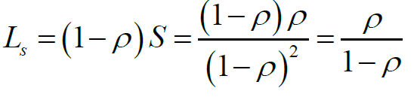
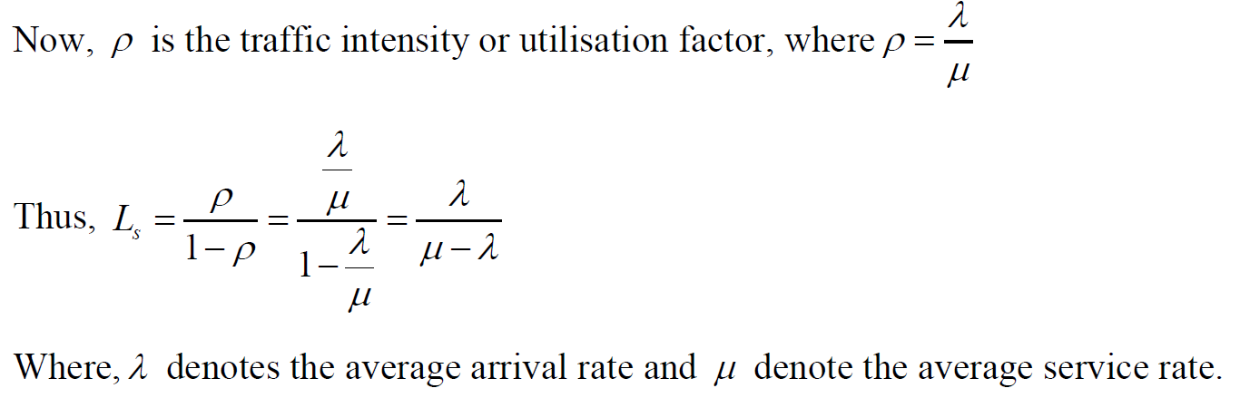
Operating Characteristics or Measures of Performances of the Model M/M/1
1.The average number of customers (units) in the system is given by

Slide 25
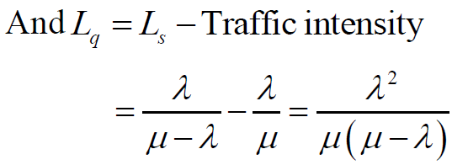
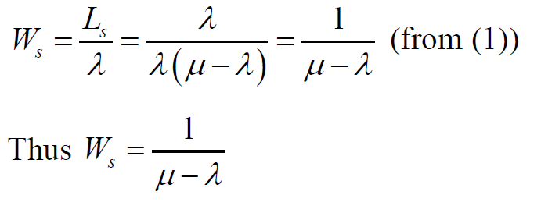
Operating Characteristics or Measures of Performances of the Model M/M/1
2. The average queue length (Expected number of customers) is Lq
3. The average time an arrival spends in the system (Expected waiting time in system) is

Slide 26
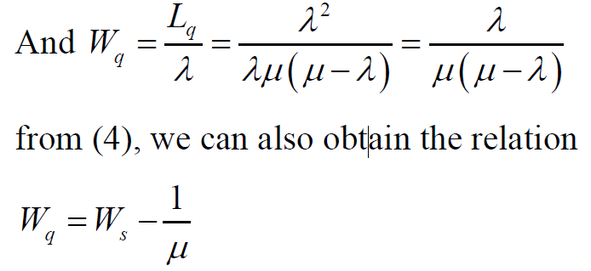

Operating Characteristics or Measures of Performances of the Model M/M/1
4. The average waiting time of an arrival in the queue is Wq
5. The probability that the number of customers (units) waiting in the queue and the number of units being serviced is greater than k is

Slide 27


Operating Characteristics or Measures of Performances of the Model M/M/1
4. The probability of having a queue i.e.

Slide 28
The Poisson distribution is a discrete probability distribution that expresses the probability of a given number of events occurring in a fixed interval of time or space if these events occur with a known constant mean rate and independently of the time since the last event.
The exponential distribution or negative exponential distribution is the probability distribution of the time between events in a Poisson point process, i.e., a process in which events occur continuously and independently at a constant average rate.

Slide 29
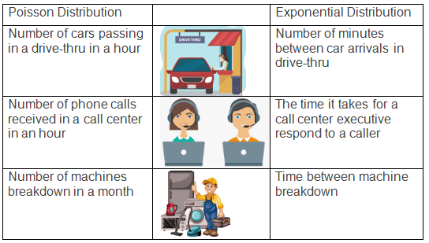

Slide 30
M/M/1 (Poisson Arrival / Poisson output / Number of channels / Infinite capacity / FIFO Model)
A T.V. Repairman finds that the time spent on his jobs have an exponential distribution with mean of 30 minutes. If he repairs sets in the order in which they come in, and if the arrival of sets is approximately Poisson with an average rate of 10 per 8 hour day, what is repairman's expected idle time each day? How many jobs are ahead of the average set just brought in?

Slide 31
M/M/1
Solution: This problem is Poisson arrival/Negative exponential service / single channel /infinite capacity/ FIFO type problem.
Data: λ = 10 sets per 8 hour day = 10 / 8 = 5/4 sets per hour.
Given 1/μ = 30 minutes, hence μ = (1/30) × 60 = 2 sets per hour.
Hence, Utility ratio = ρ = (λ /μ) = (5/4) / 2 = = 5 / 8. = 0.625.
This means out of 8 hours 5 hours the system is busy i.e. repairman is busy.
Probability that there is no queue = The system is idle = (1− ρ) = 1  (5 / 8) = 3 / 8 = That is out
of 8 hours the repairman will be idle for 3 hours.
Number of sets ahead of the set just entered = Average number of sets in system = λ / (μ − λ) =
= ρ / (1− ρ) = 0.625 / (1  0.625) = 5 / 3 ahead of jobs just came in.

Slide 32
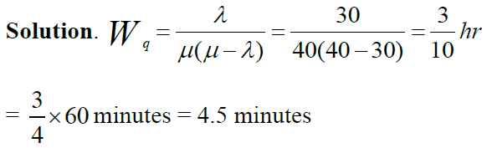
M/M/1
Customers arrive at a box office window being served by a single individual according to a Poisson input process with a mean rate of 30 per hour. The time required to serve a customer has an exponential distribution with a mean of 90 seconds. Find the average waiting time of a customer in the queue.

Slide 33
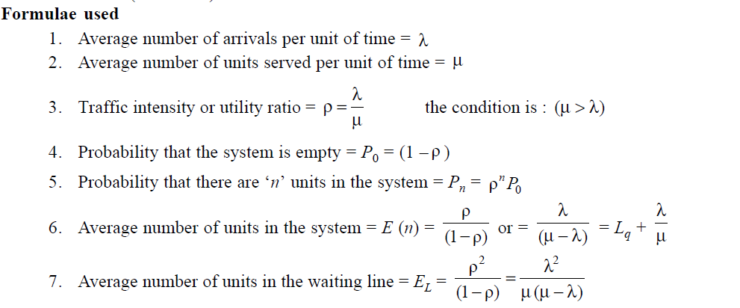
M/M/1

Slide 34
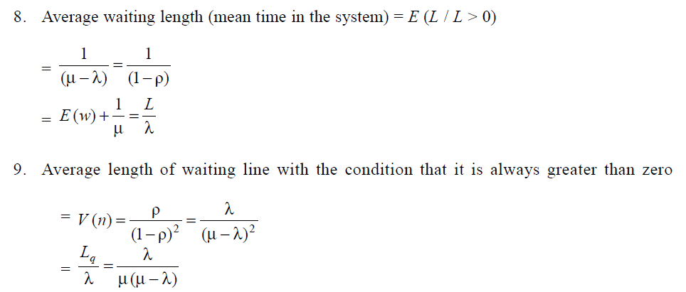
M/M/1

Slide 35
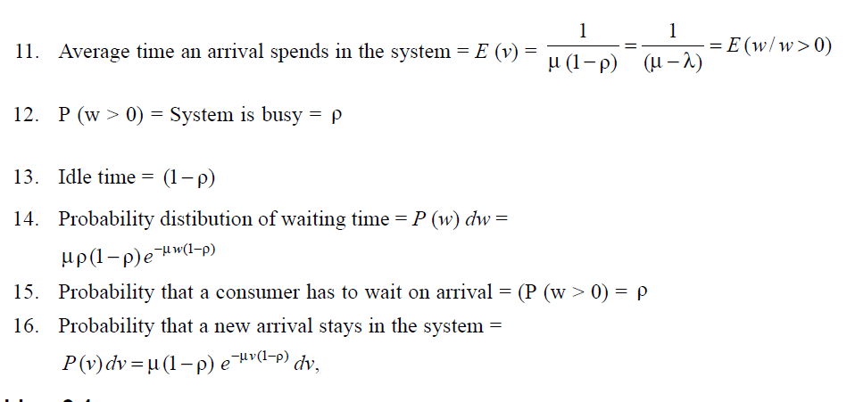
M/M/1

Slide 36
M / M / 1 / (∞ / FIFO):
In a departmental store one cashier is there to serve the customers. And the customers pick up
their needs by themselves. The arrival rate is 9 customers for every 5 minutes and the cashier can serve 10 customers in 5 minutes. Assuming Poisson arrival rate and exponential distribution for service rate,
find:
(a) Average number of customers in the system.
(b) Average number of customers in the queue or average queue length.
(c) Average time a customer spends in the system.
(d) Average time a customer waits before being served.

Slide 37
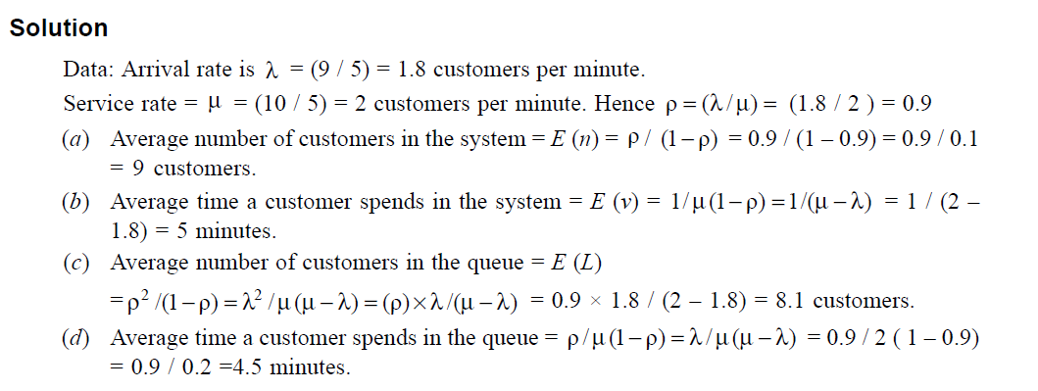
M / M / 1 / (∞ / FIFO):

Slide 38
M / M / 1 / (∞ / FIFO):
Vehicles are passing through a toll gate at the rate of 70 per hour. The average time to pass through the gate is 45 seconds. The arrival rate and service rate follow Poisson distribution. There is a complaint that the vehicles wait for a long duration. The authorities are willing to install one more gate to reduce the average time to pass through the toll gate to 35 seconds if the idle time of the toll gate is less than 9% and the average queue length at the gate is more than 8 vehicle, check whether the installation of the second gate is justified?

Slide 39
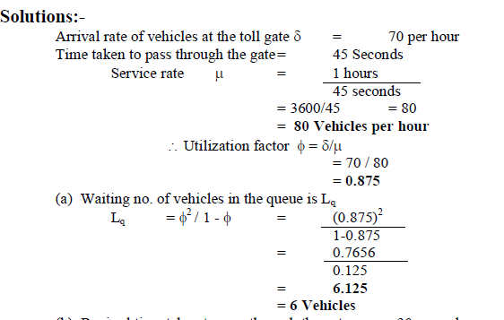
M / M / 1 / (∞ / FIFO):

Slide 40
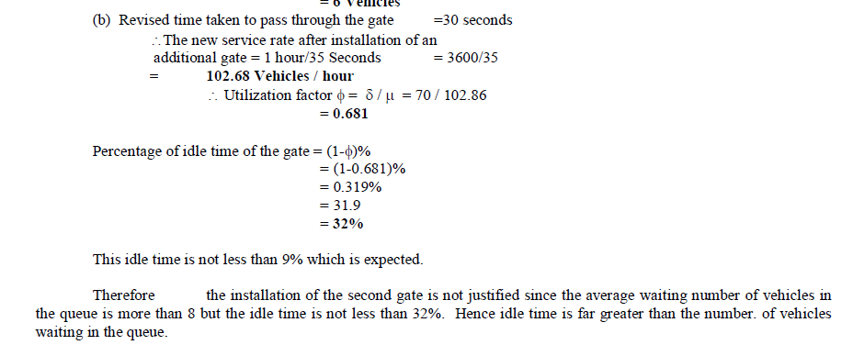
M / M / 1 / (∞ / FIFO):

Slide 41
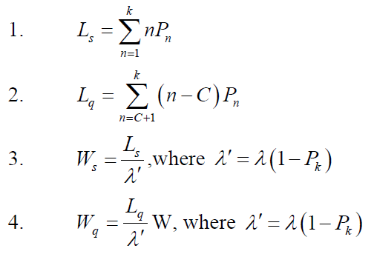
Operating Characteristics/Performance Measures of the M/M/C/K Queueing Model

Slide 42
Operating Characteristics/Performance Measures of the M/M/C/K Queueing Model
A car servicing station has two bays where service can be offered simultaneously. Due to a limitation in space, only four cars are accepted for servicing. The arrival pattern is Poisson with 12 cars per day. The service time for both the bays is exponentially distributed with 8 cars per day per bay. Find the average number of cars in the service station, the average number of cars waiting to be serviced and the average time a car spends in the system.

Slide 43
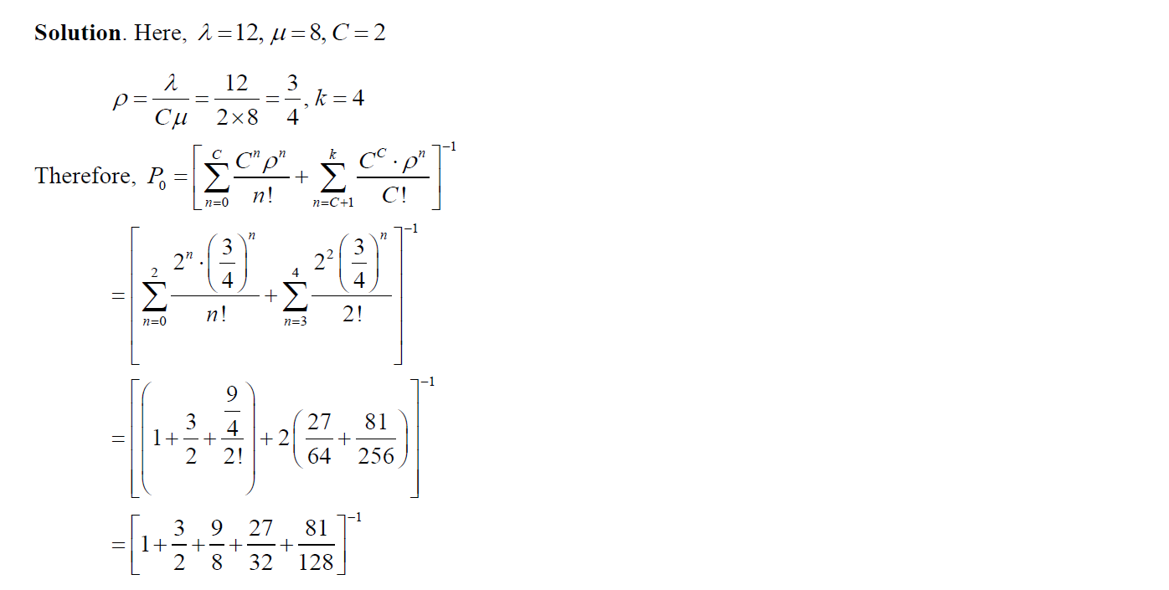
Operating Characteristics/Performance Measures of the M/M/C/K Queueing Model

Slide 44
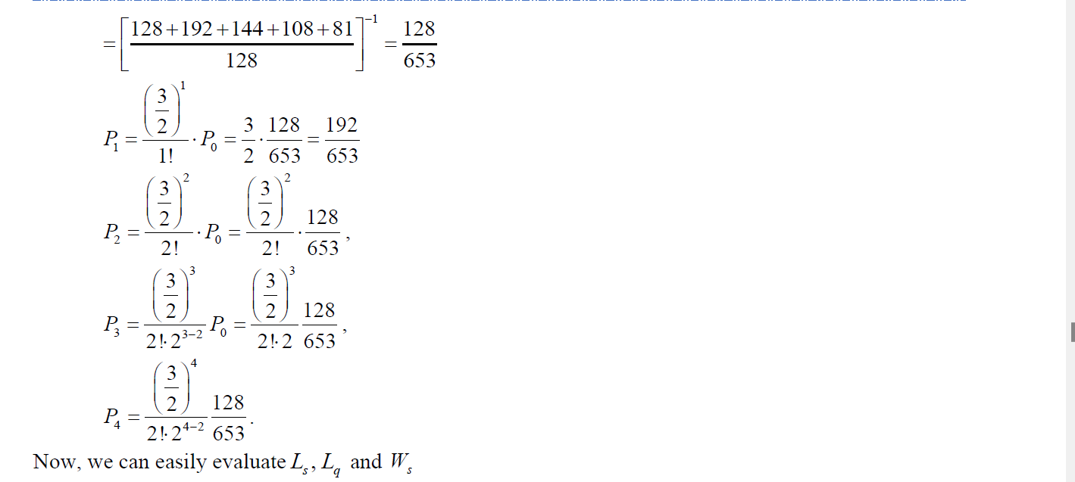
Operating Characteristics/Performance Measures of the M/M/C/K Queueing Model

Slide 45
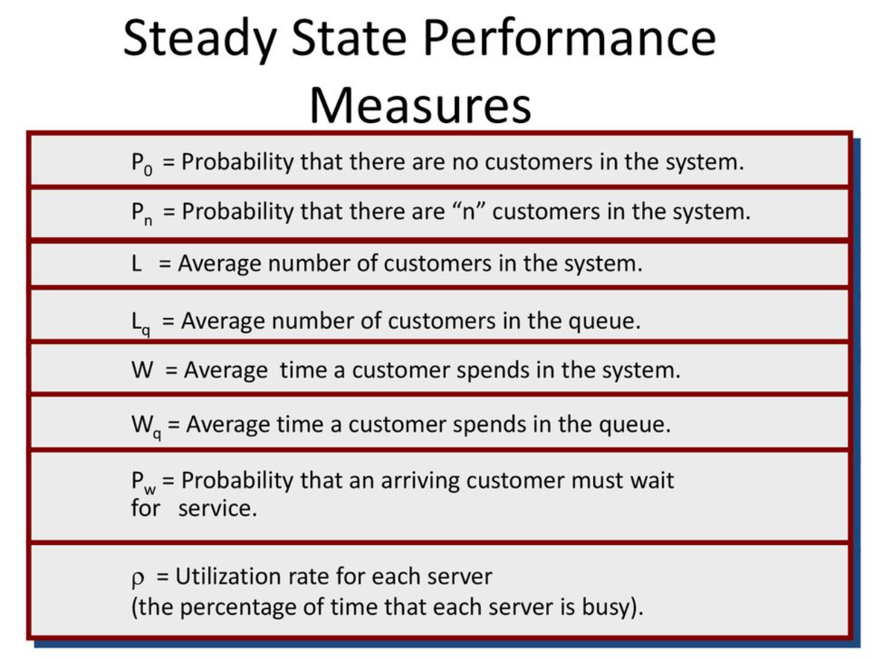

Slide 46
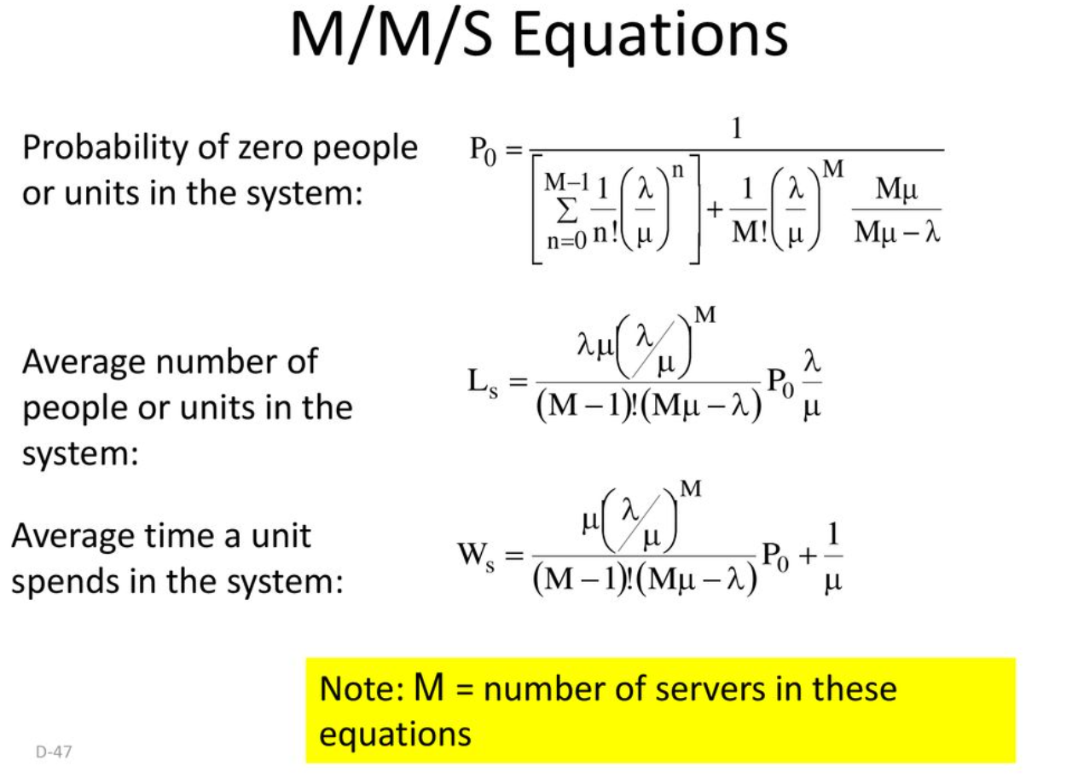

Slide 47
